Slide 1
File Processing
NOTES

Slide 2
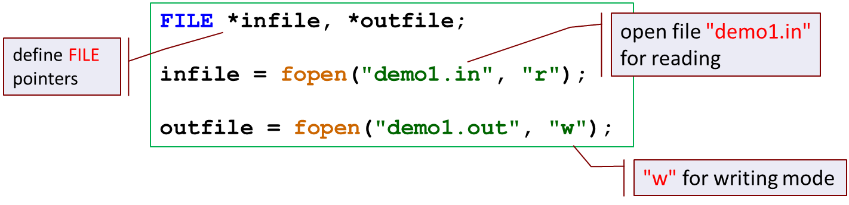
Opening a File and File Modes
Note that
In "r" mode, file must already exist.
In "w" mode, new data will overwrite existing file data (if any).

Slide 3
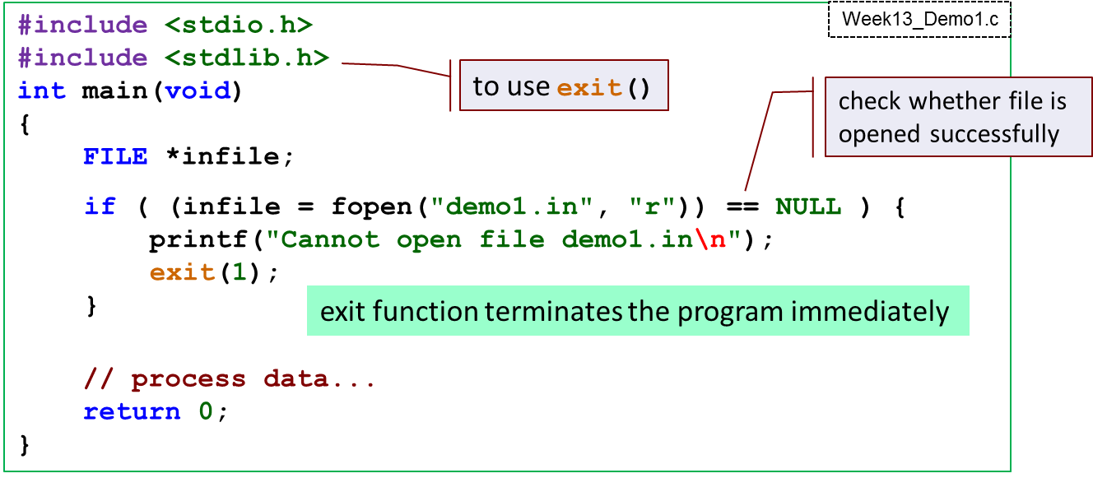
Opening a File
We often use fopen() function with error checking routine
If file is opened successfully, returns a pointer pointing to the first data in the file.
If file is failed to be opened, a NULL pointer will be returned.

Slide 4
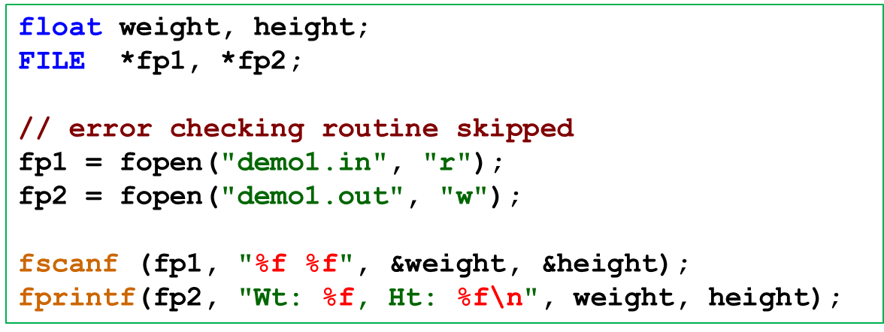
Reading a file
fscanf read data from a file.
fprintf write data to a file.
The use of fscanf and fprintf is similar to scanf and printf.
except for the additional FILE * pointer argument

Slide 5
Reading/Writing a file What if we are not aware of the total number of the data in the file?
fscanf returns EOF if it fails to read any data; otherwise, it returns the number of data that were read and stored.
EOF is a macro (constant) whose value is commonly -1.
Assuming that file contains no error, then a return value of EOF means you have reached the end of the file.
FILE *fp;
int var;
// open file using pointer fp
//while (fscanf(fp, "%d", &val) == 1)
while ( fscanf(fp, "%d", &var) != EOF )
{
printf("%d\n", var);
}
Input file:
10 20 30 40
10
20
30
40

Slide 6
Closing a file (Good practice)
#include <stdio.h>
int main(void)
{
FILE *infile, *outfile;
infile = fopen("demo1.in", "r");
outfile = fopen("demo1.out", "w");
// error checking routine skipped
// data reading and writing skipped here
fclose(infile);
fclose(outfile);
return 0;
}
close the file stream represented by this pointer variable

